Slide 1
Sprint Review
08.11.2017 - 14.11.2017

Slide 2
Scrum Process

Slide 3
Our Schedule
Thursday’s: In-person sprint planning
Friday - Sunday: Working on tasks, Scrums via Slack if adequate
Monday: Scrum via Skype
Tuesday: Finish tasks, prepare sprint review
Wednesday: Sprint review, afterwards short retrospective

Slide 4
Tools We Use
GitLab: Code & task/feature management
Slack: Daily communication
Skype: Weekly online meetings
Google Drive: Collaborative work on documents

Slide 5
Closer Look at GitLab

Slide 6
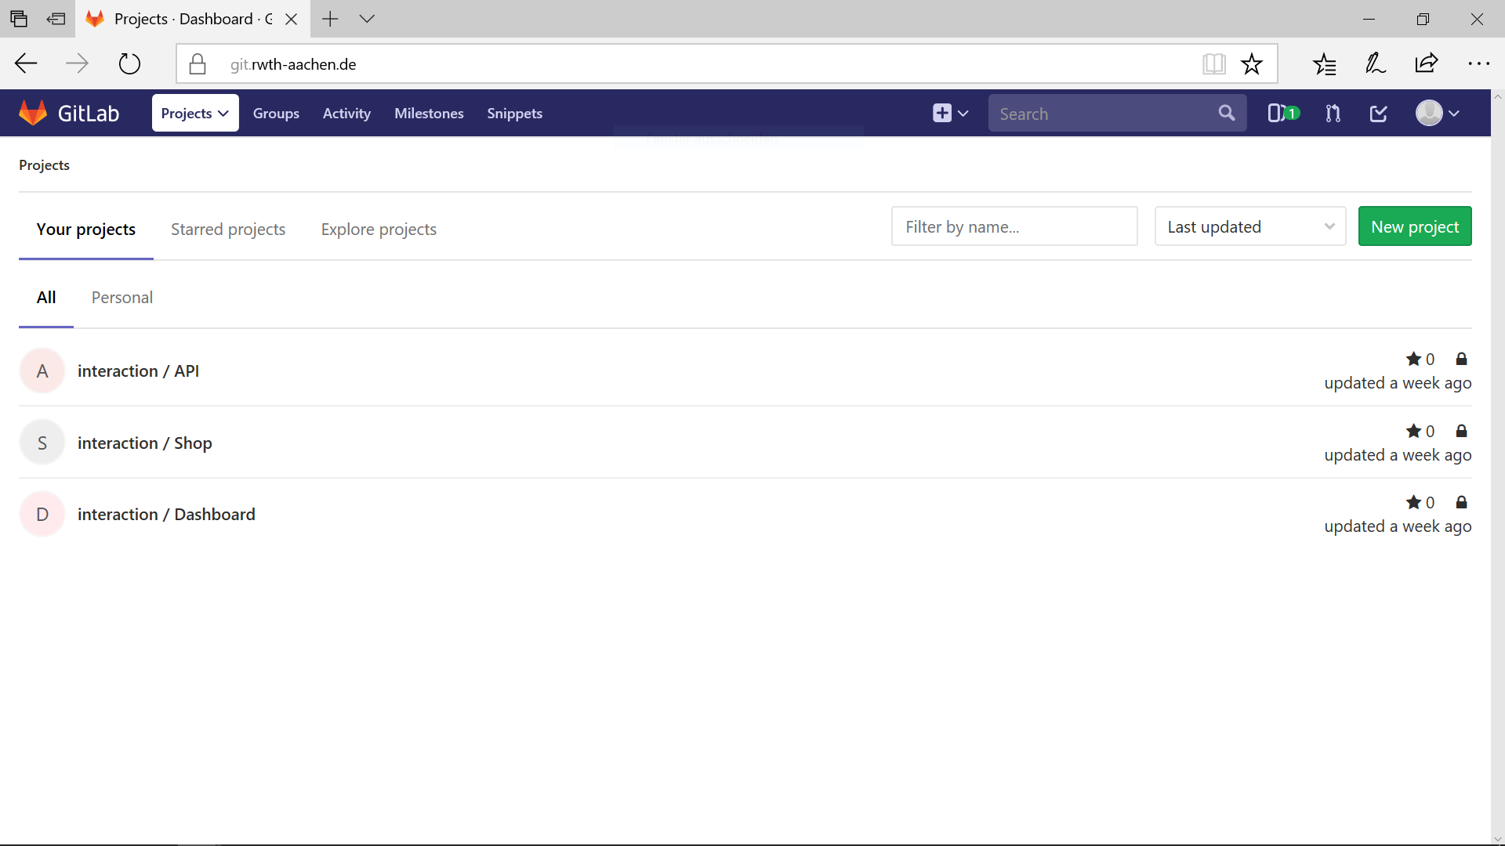

Slide 7
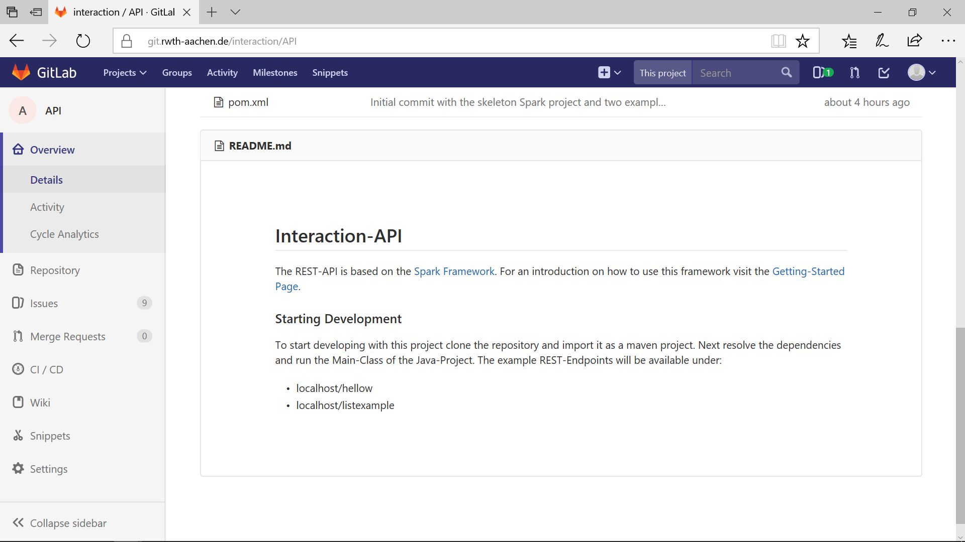

Slide 8
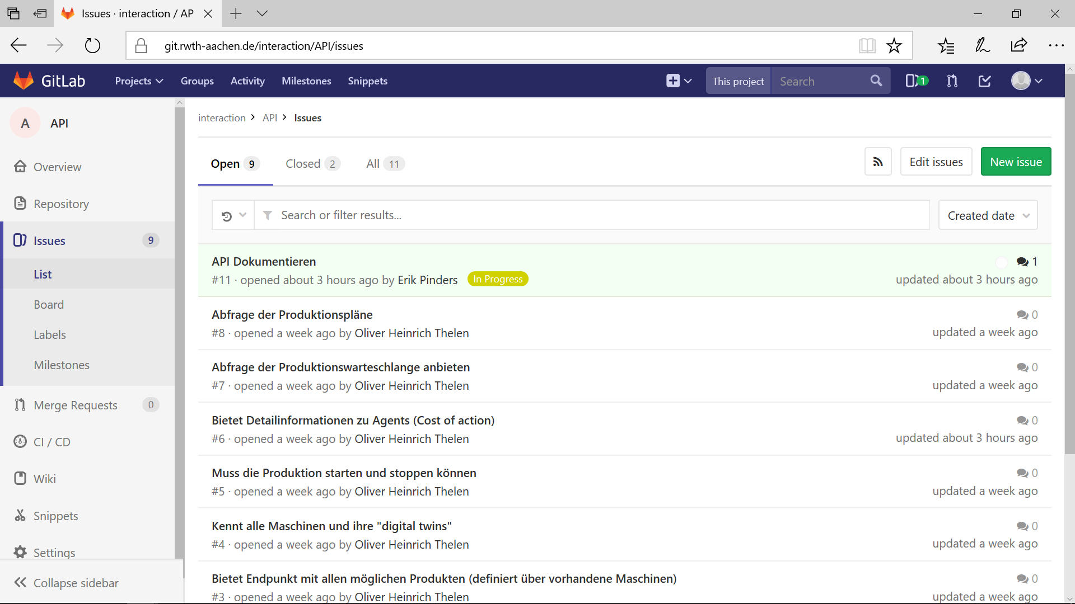

Slide 9
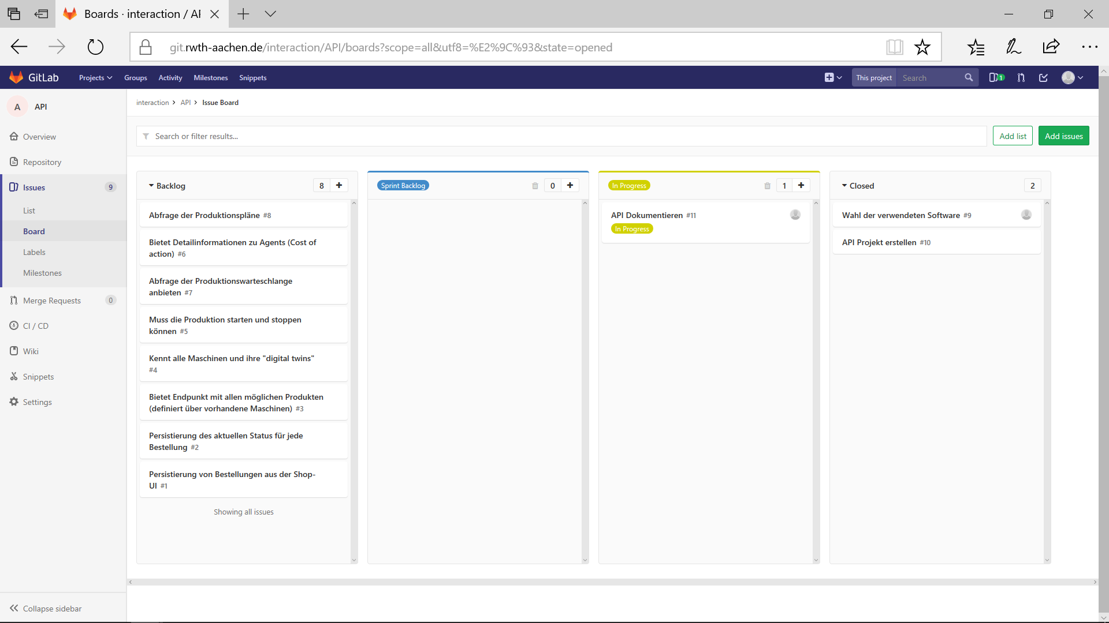

Slide 10
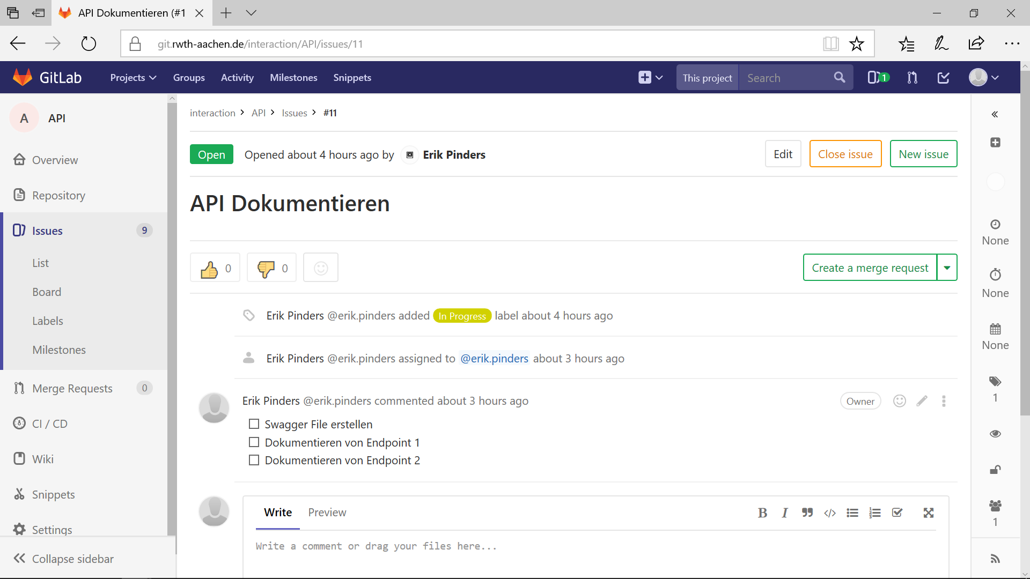

Slide 11
Sprint Results

Slide 12
Dashboard

Slide 13
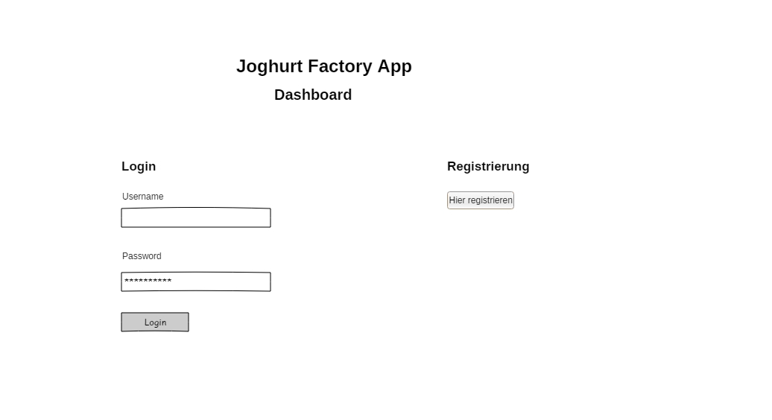

Slide 14
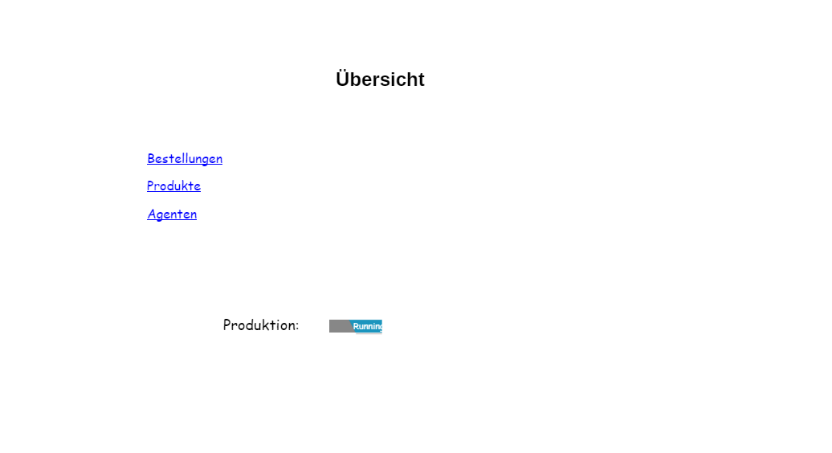

Slide 15
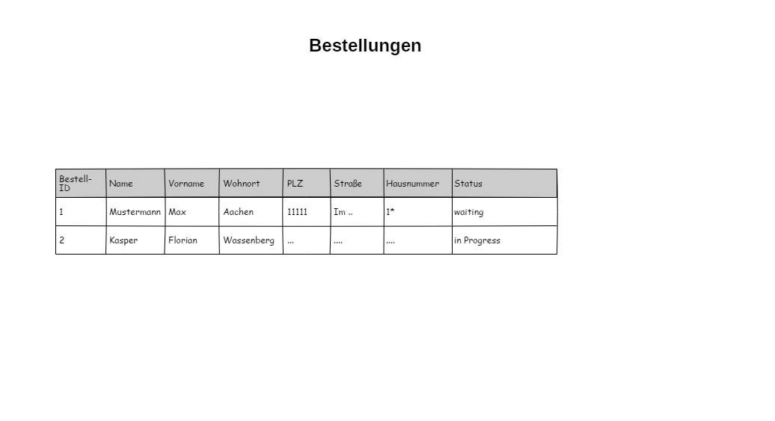

Slide 16
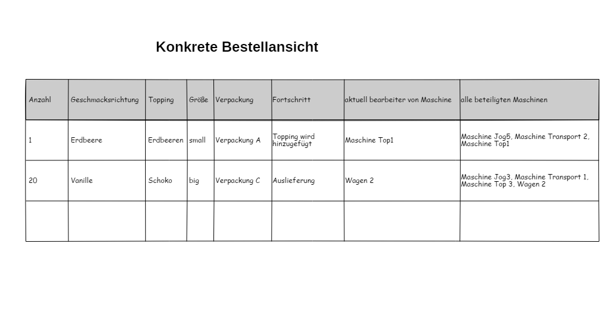

Slide 17
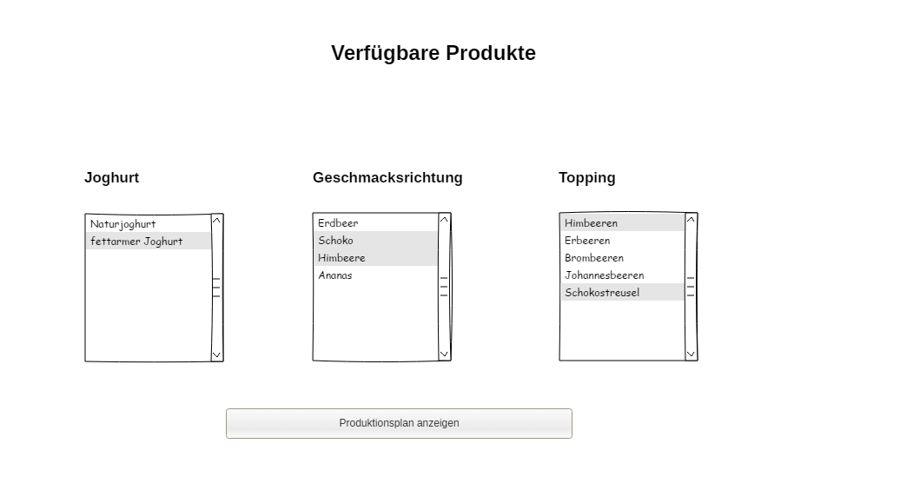

Slide 18
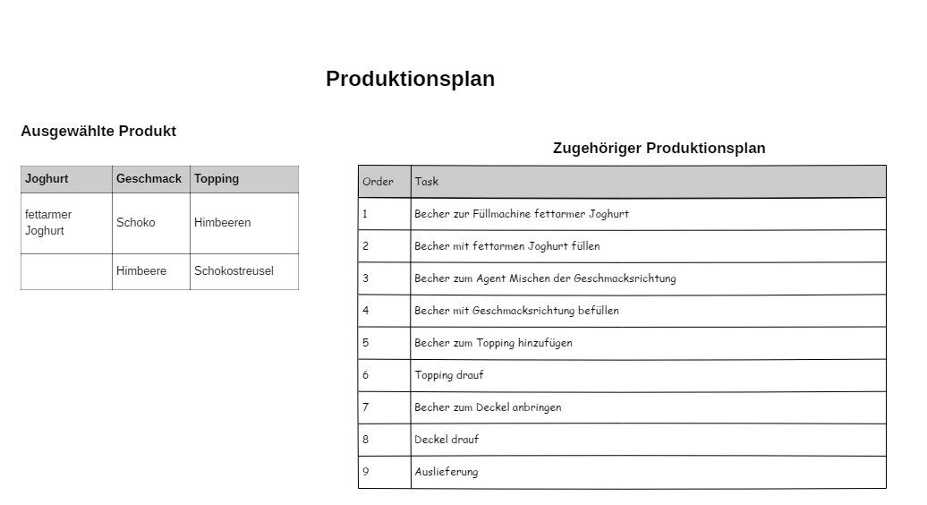

Slide 19
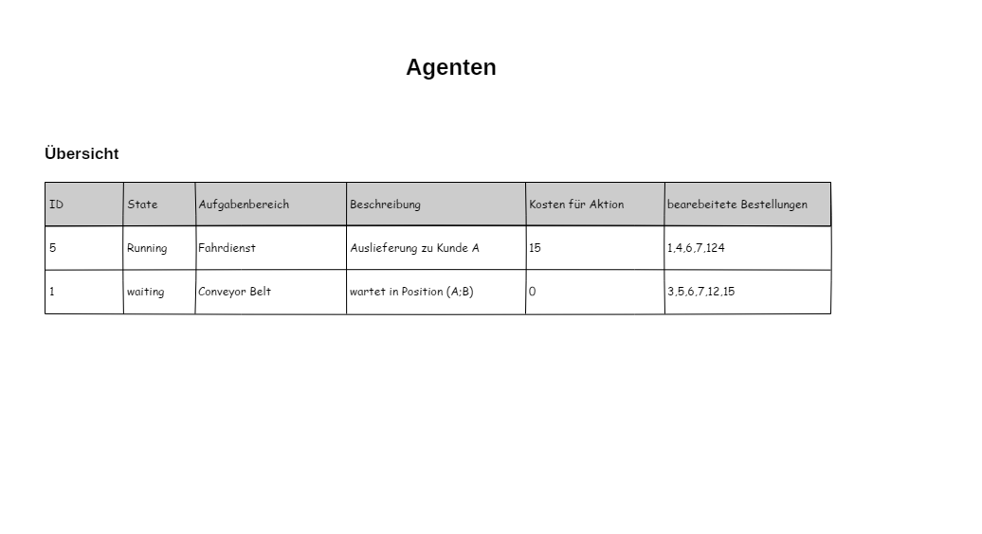

Slide 20
Shop
ShopUI to present the product
ShopUI for customers to enter their order(s)
Registration/Login possible to save one’s data
Shopping Cart to keep an overview
Different payment options possible (optional)

Slide 21
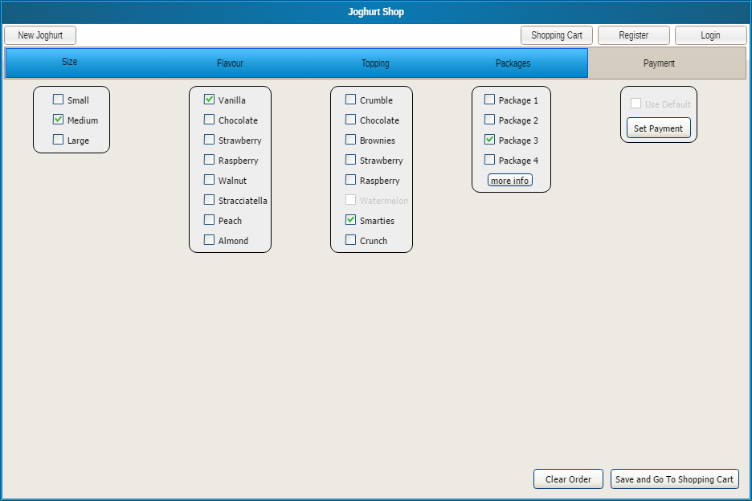

Slide 22
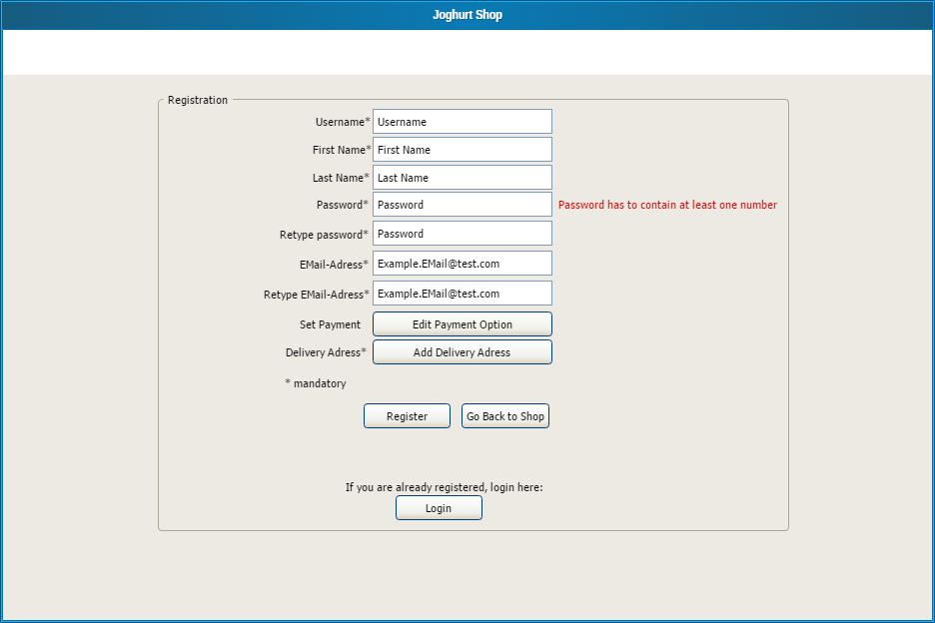

Slide 23
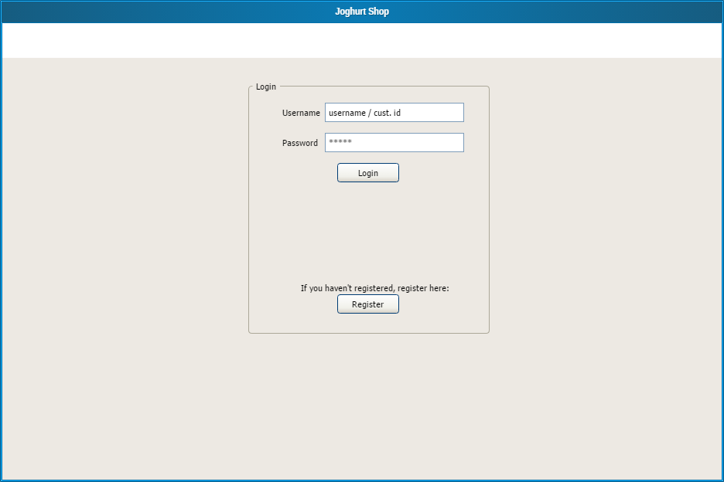

Slide 24
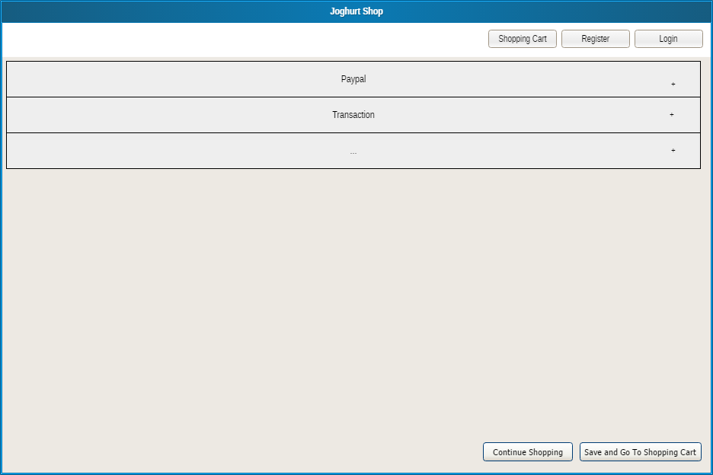

Slide 25
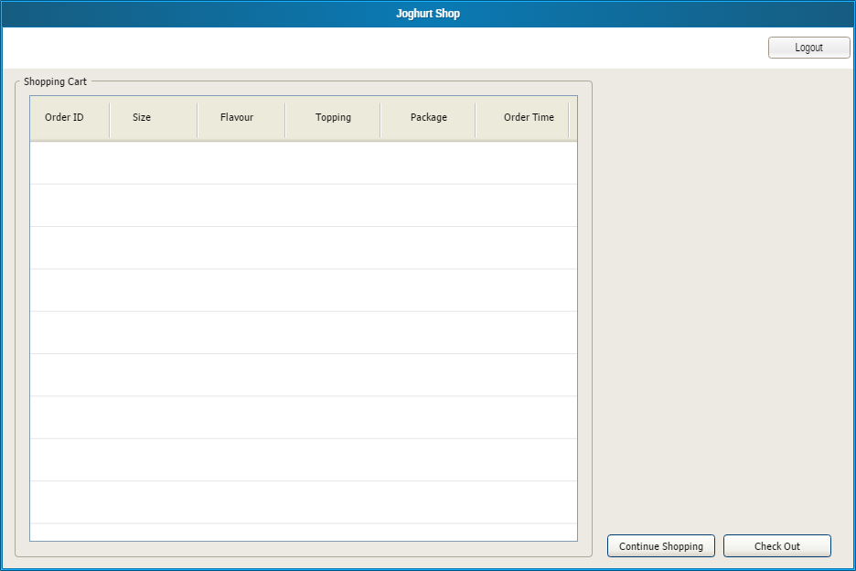

Slide 26


Interaction-API
Java-based REST-API via the Spark Microframework
Delivers the frontends for both the Shop and the Dashboard to the clients
Persists data like orders in a database

Slide 27
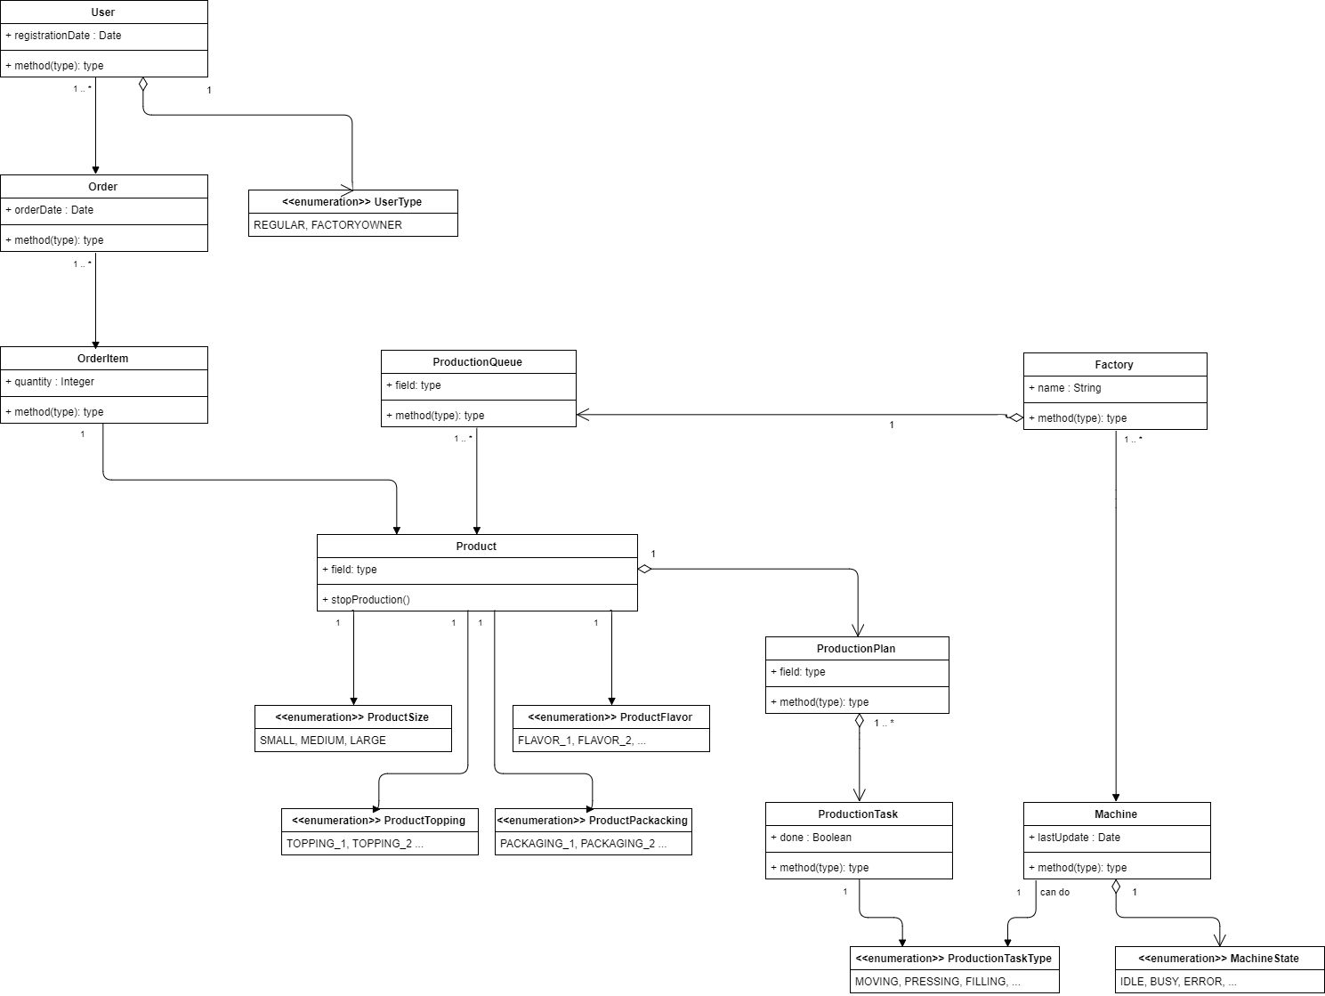
Interaction-API

